Slide 1

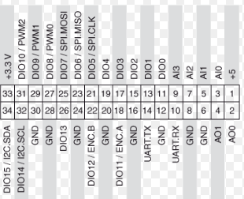
1
2
3
4
5
6
7
8
9
10
Female
connector
VGA
Pin 2: VCC
Pin 3: GND
Pin 6: A
Pin 8: B
Pot VIN
Pot VO
Pin 5
GND
Pin 3
Pin 2
Pin 14
Pin 15
Pin 5
GND
Pin 3
Pin 2
Pin 14
Pin 15
Pin 1: +5V
Pin 6: GND
Pin 18: ENC A
Pin 22: ENC B
Pin 1 : +5V
Pin 3: AIO 0
MyRIO pin 1 to encoder pin 2: VCC (5V as per specs)
MyRIO pin 6 to encoder pin 3: GND
MyRIO pin 18 to encoder pin 6: channel A
MyRIO pin 22 to encoder pin 8: channel B.

